Slide 1
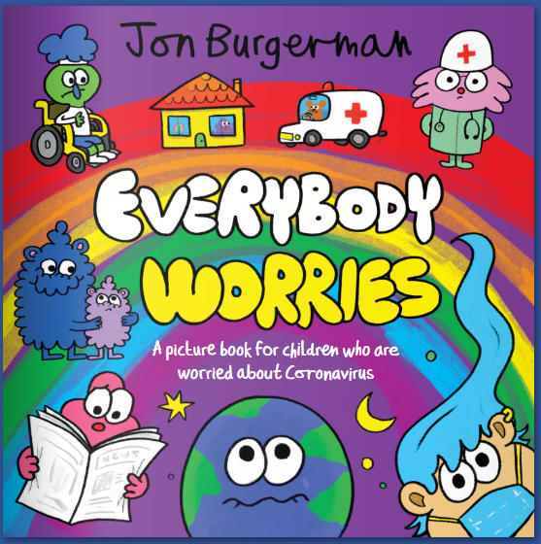
Reading task
Today we’re going to talk about worries. We are going to read a story and then answer some questions.
After you could have a go at completing some of Miss Sparkes’ well-being activities.

Slide 2
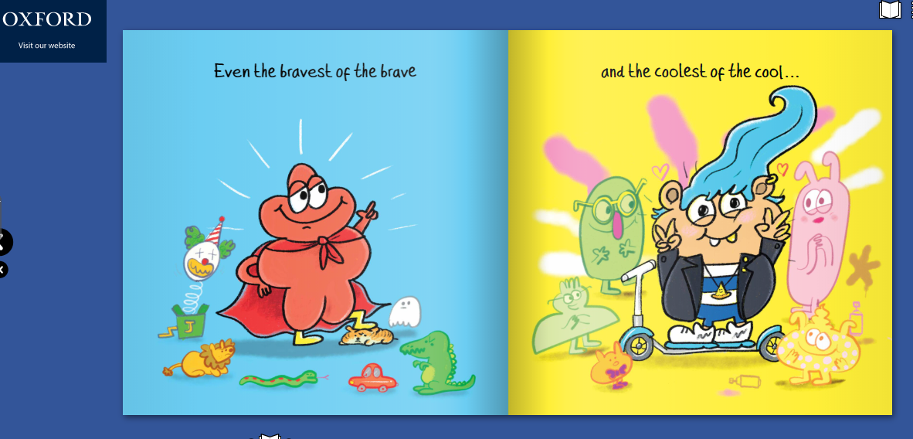

Today we’re going to read a book…
Everybody Worries
Everyone has worries and that is ok. If you share your worries it can help them to go away. Read the story – ‘Everybody worries’ by clicking on this link.
https://en.calameo.com/read/000777721945cfe5bb9cc?authid=Xu9pcOzU3TQx

Slide 3

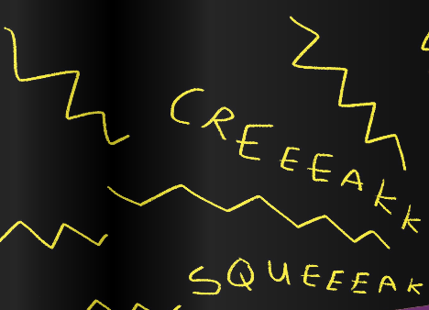
Answer these questions about the text in your home learning book.
1. Does everyone worry about the same things?
________________________________________________________
2. Fill in the gaps:
Even the _________ of the brave and the __________ of the cool can worry about something big or worry about something __________.
3. What made the noises in the dark?
________________________________________________________

Slide 4
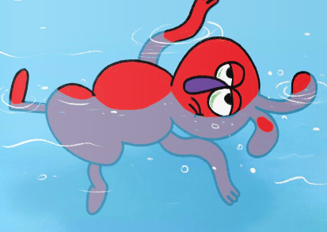
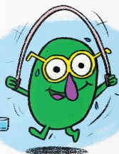
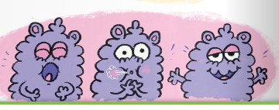
4. How might someone be feeling if they are worried about something? What effect might it have on your body?
________________________________________________________________________________________________________________
5. Have you ever been worried about something? Tell me about it….
____________________________________________________________________________________________________________________
6. What can you do if you are worried about something? Give at least 3 different ways.
__________________________________________________________
____________________________________________________________________________________________________________________

Slide 5
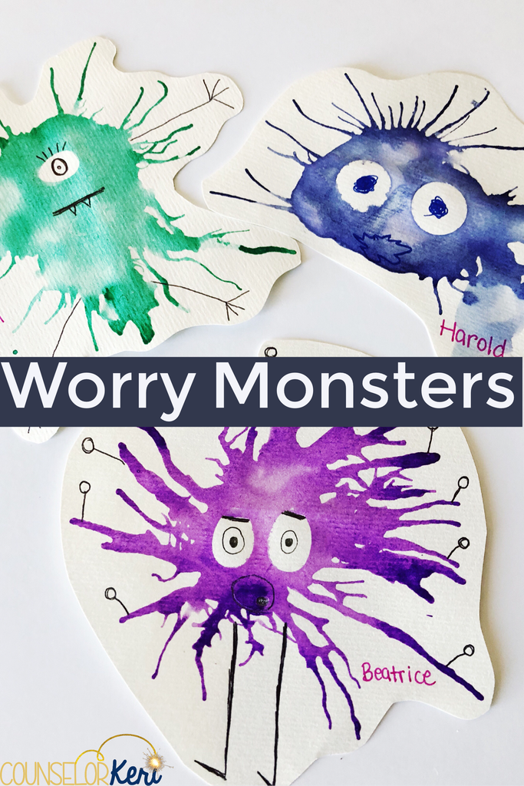
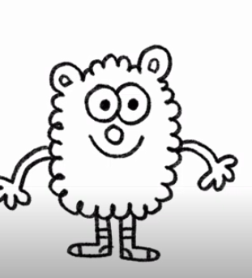
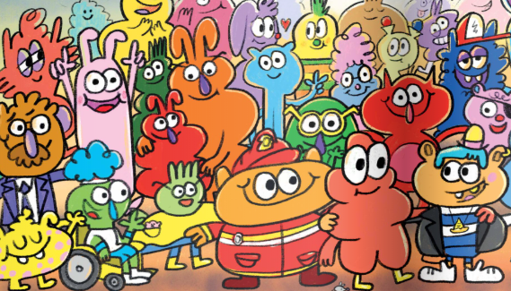
7. The author of this story draws all different types of worries as characters. Can you draw your own worry characters? You could label them with your own worries or give them names.
https://www.youtube.com/watch?v=ST3WHJt4fZw Watch the author draw the characters here.

Slide 6


Slide 7
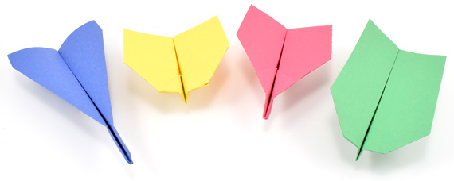

Well-being time…. Activity 1
We would like you to write down any worries you have on a piece of paper. It might be about school, about lockdown or about when you will return to school. Perhaps it might be about being in a new classroom or group. It could be anything! Remember everyone worries and people will have different worries. Now share your worries with your trusted adult. You could send them to us if you wanted by email.
Now turn your piece of paper into a paper aeroplane. Take 3 big breaths and let your worries fly away. Throw your paper plane and let your worries go………..

Slide 8
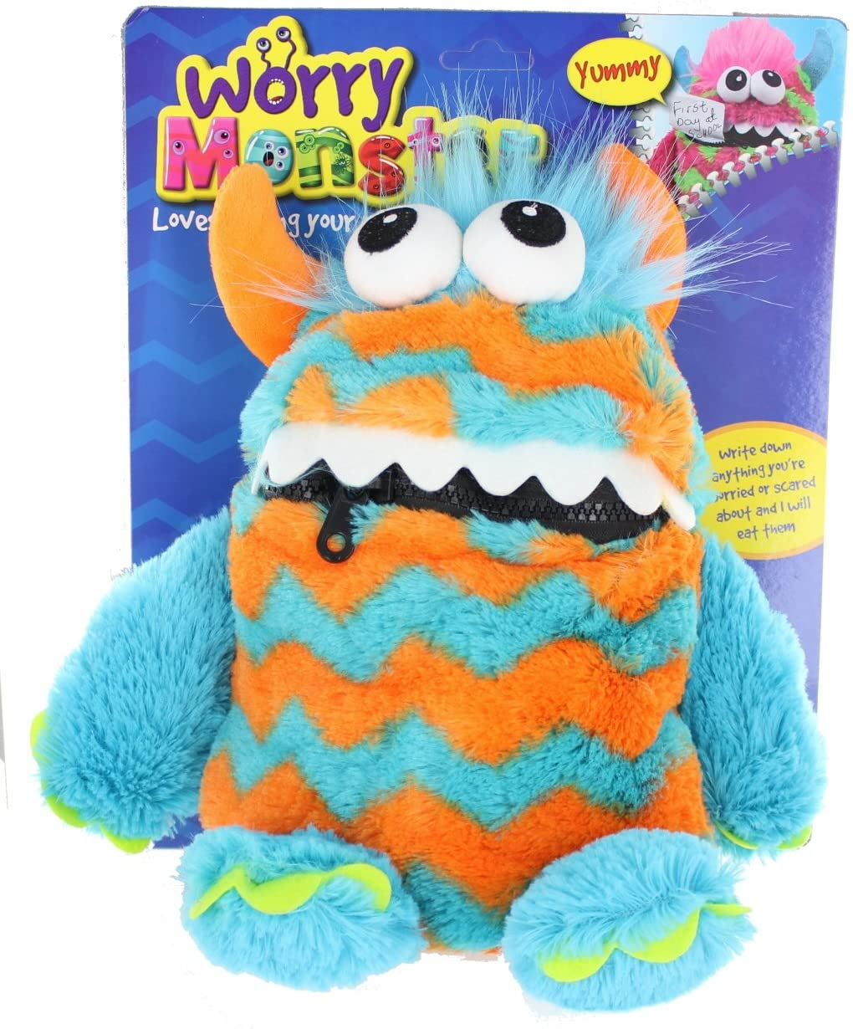
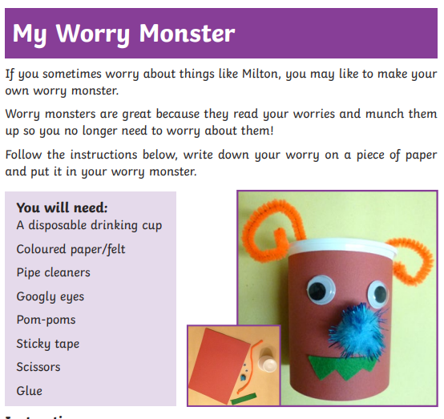
Now get creative! You could make your own worry monster….

Slide 9
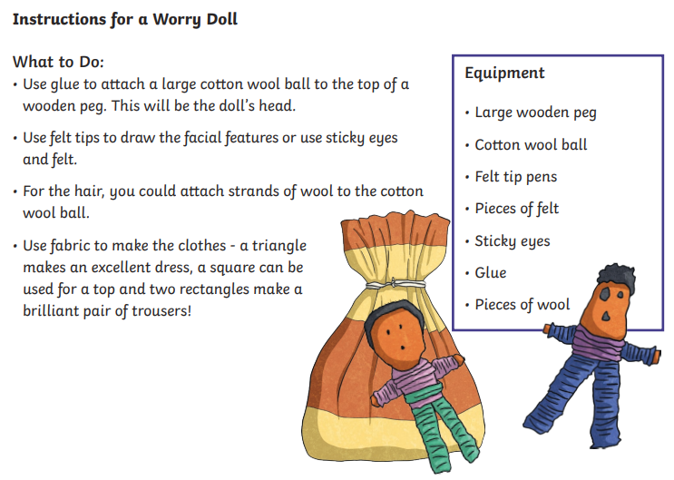
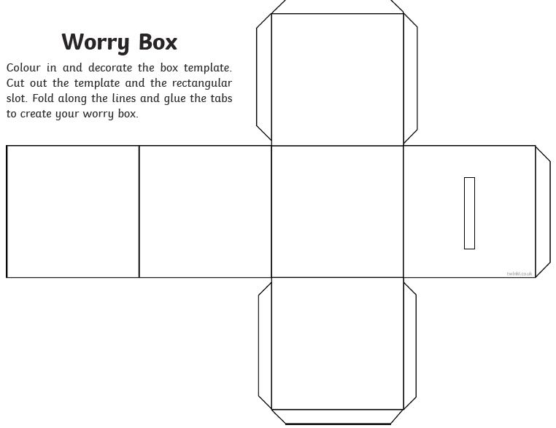
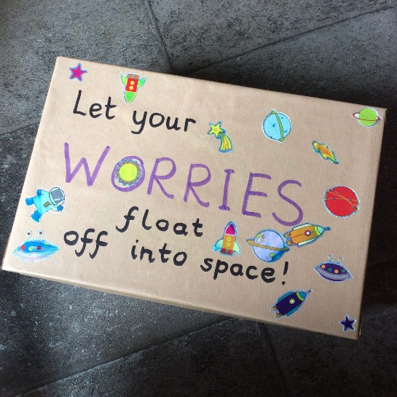
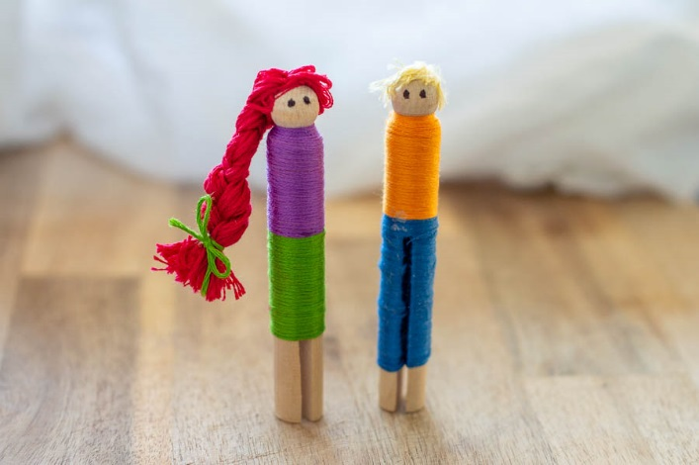
Make your own worry box or doll.

