Slide 1
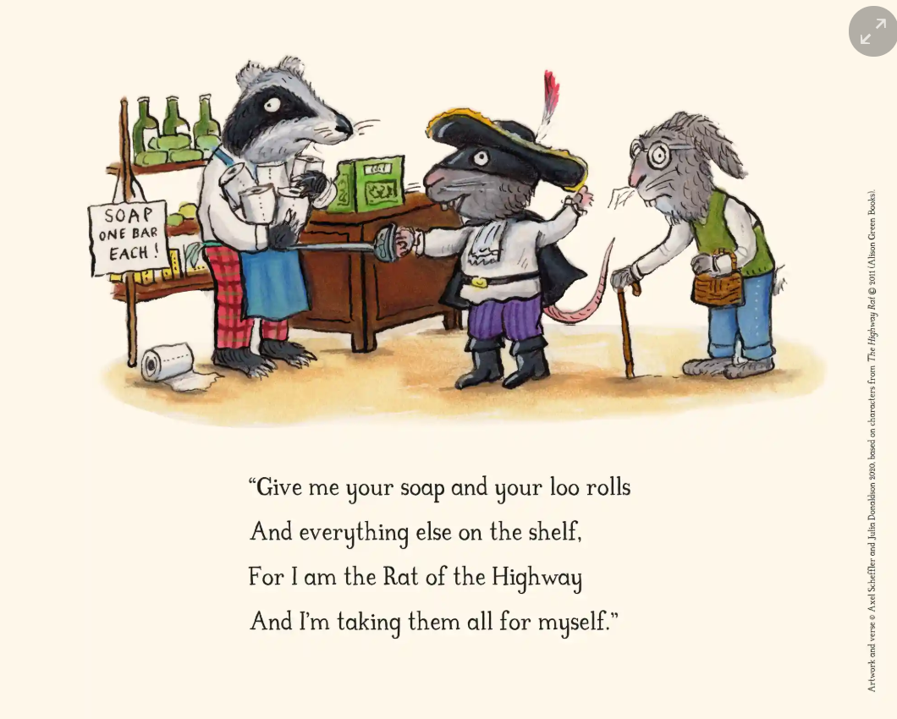
The Highway Rat
Is it right for The Highway Rat to take everything from the shelf? Why/why not?
What will happen if he takes everything?
How will affect the people around him?

Slide 2
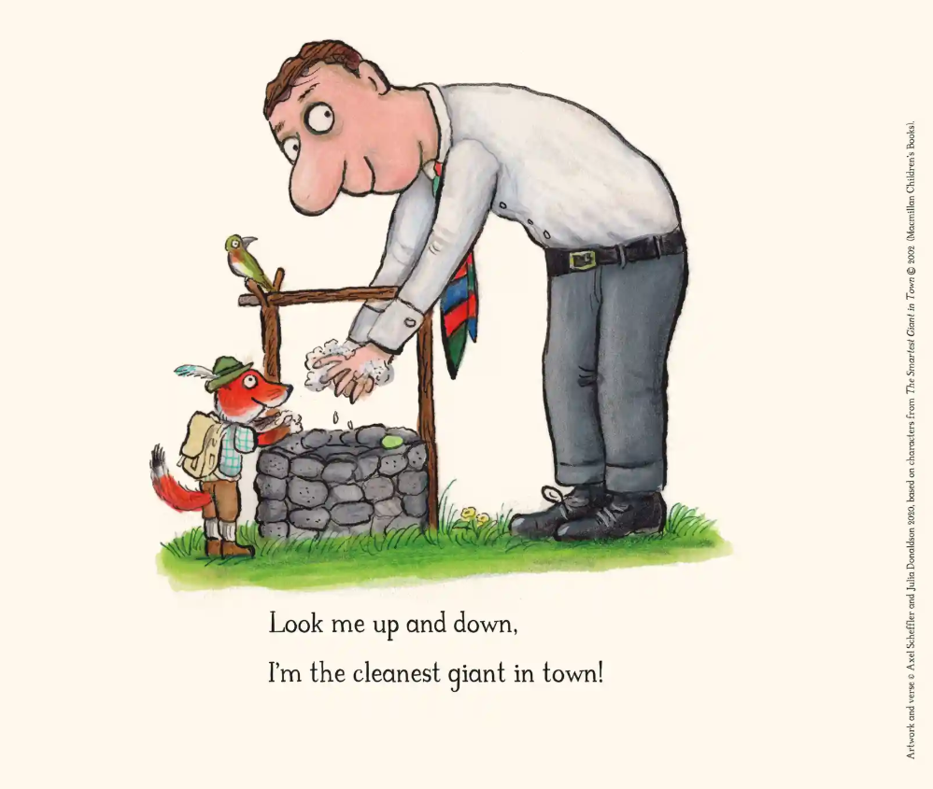
The Smartest Giant In Town
What is the Smartest Giant doing?
Why is he washing his hands?
Is it a good idea for us to wash our hands? Why/Why not?

Slide 3
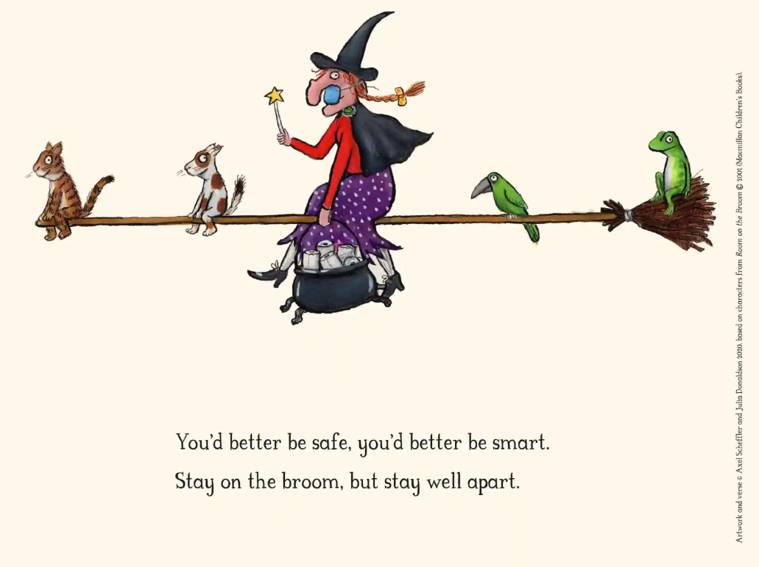
Room On The Broom
Who can you see in the picture?
Where are they?
What do you notice about the characters on the broom?
What do you think the author means by, ‘You’d better be safe, you’d better be smart.’

Slide 4
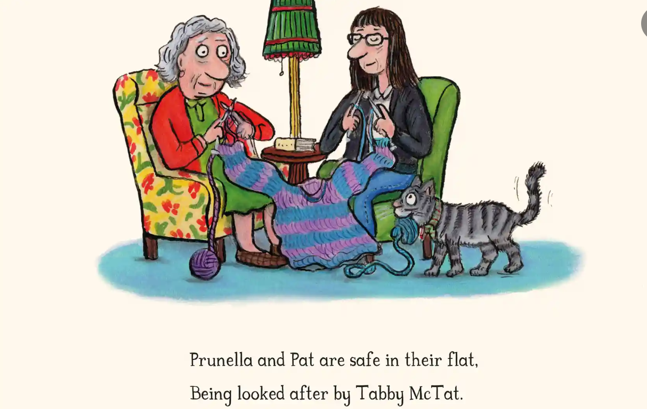
Tabby McTat
Who can you see in the picture and what are they doing?
Why are Prunella and Pat staying inside?
Can you think of ways we can help
grown-ups like Pat?

Slide 5
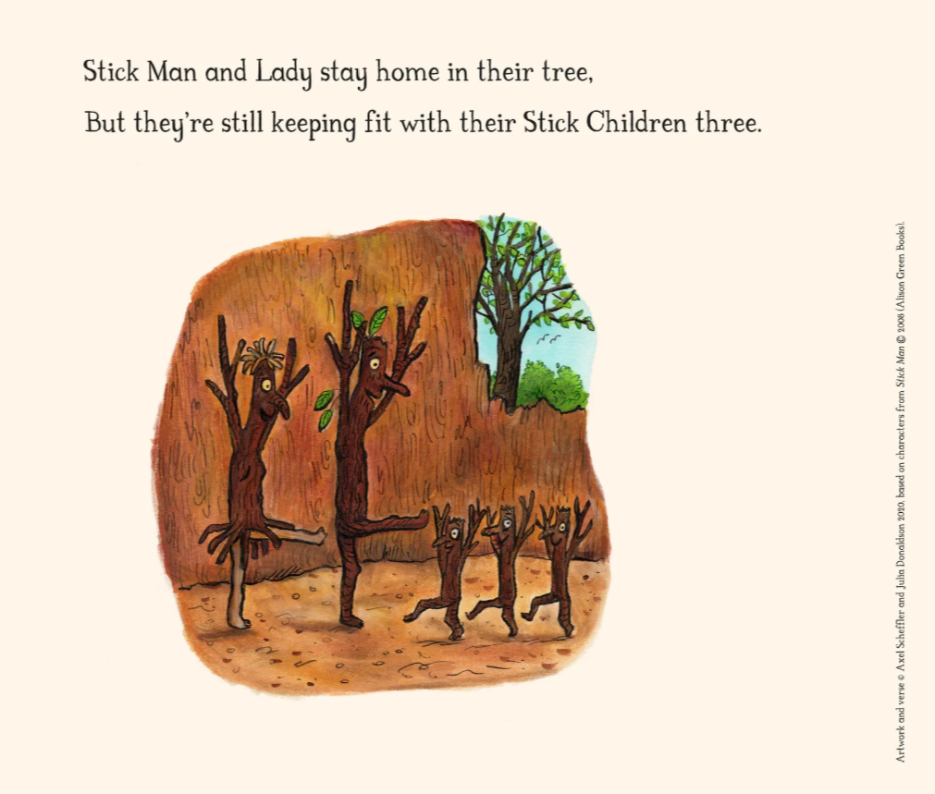
Stick Man
What things have you been doing to keep fit whilst staying indoors?
Are there any extra activities that you would like to try this week?

